Slide 1
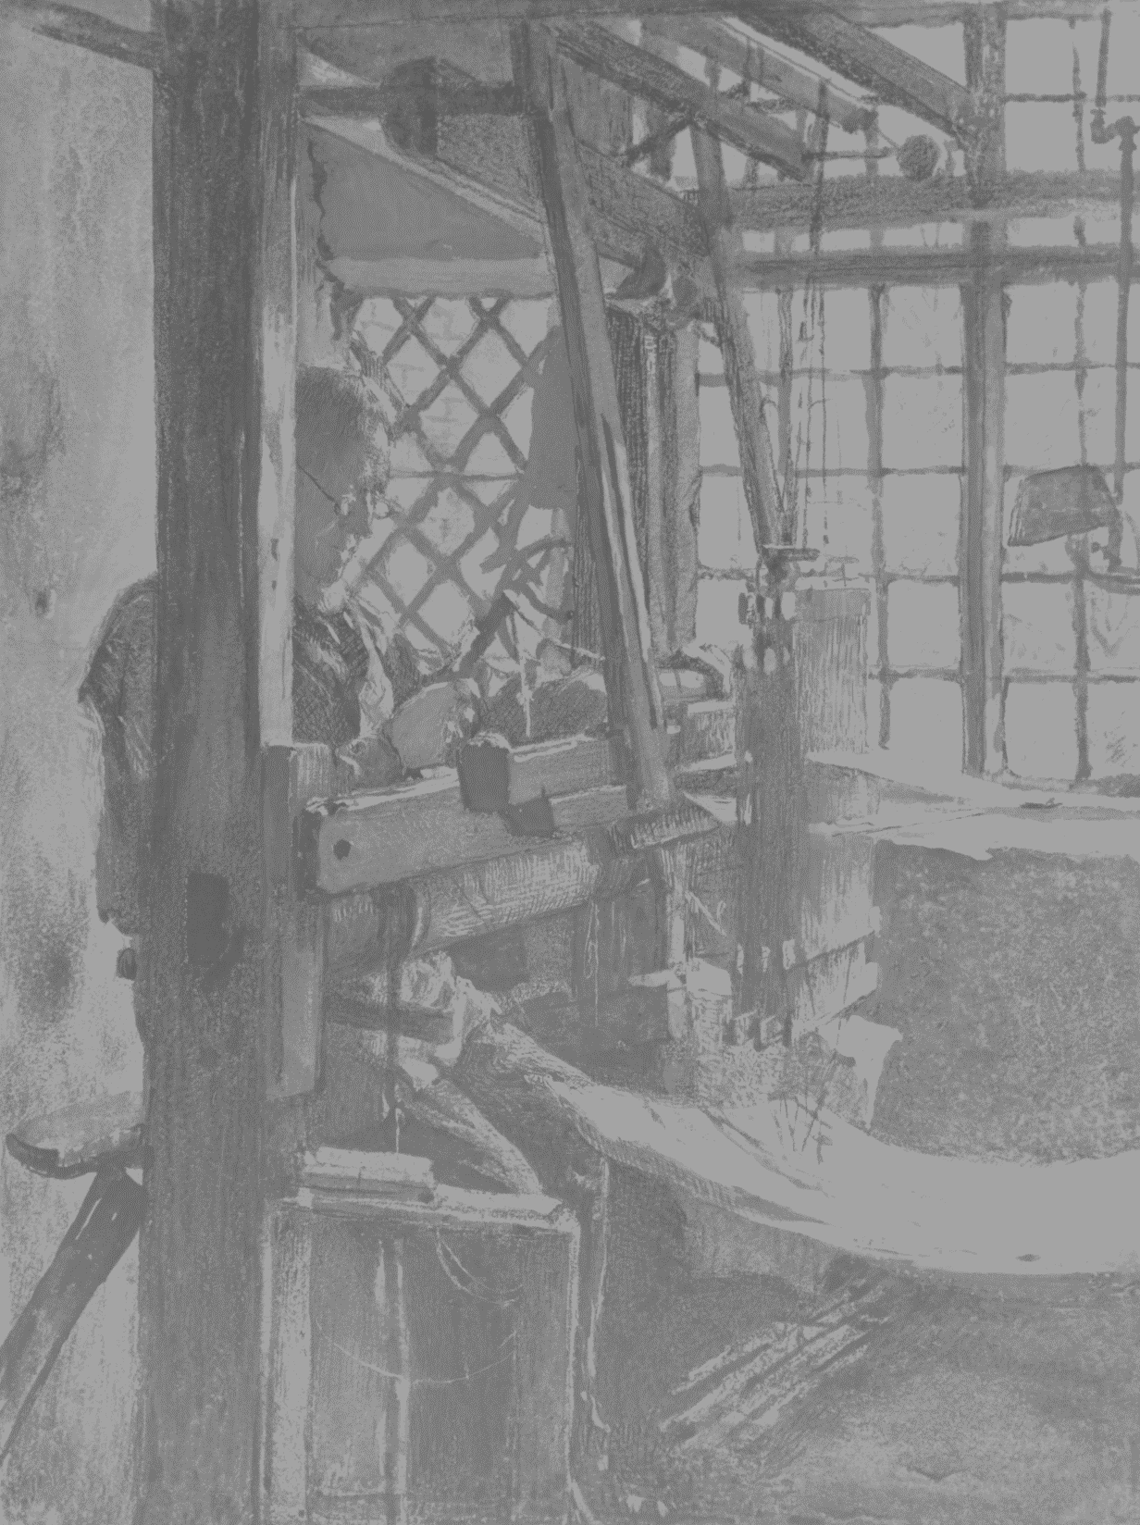
Biomarker discovery:
From handloom to factory
Paul Brack
Stoller Biomarker Discovery Centre
paul.brack@manchester.ac.uk

Slide 2
Stoller Biomarker Discovery Centre
MHRA regulated proteomic biomarker discovery and validation
£13M MRC grant to set up - Officially opened June 2016 in Citylabs
Attempting to identify proteins of clinical interest by the in silico analysis of whole proteome mass spectrometry data

Slide 3
Software problems
Novel science
Large data
Problematic software tools
  No performance optimisation
  Unreliable
  Hard to use
Research is a moving target
Not medical grade (poor reproducibility)

Slide 4
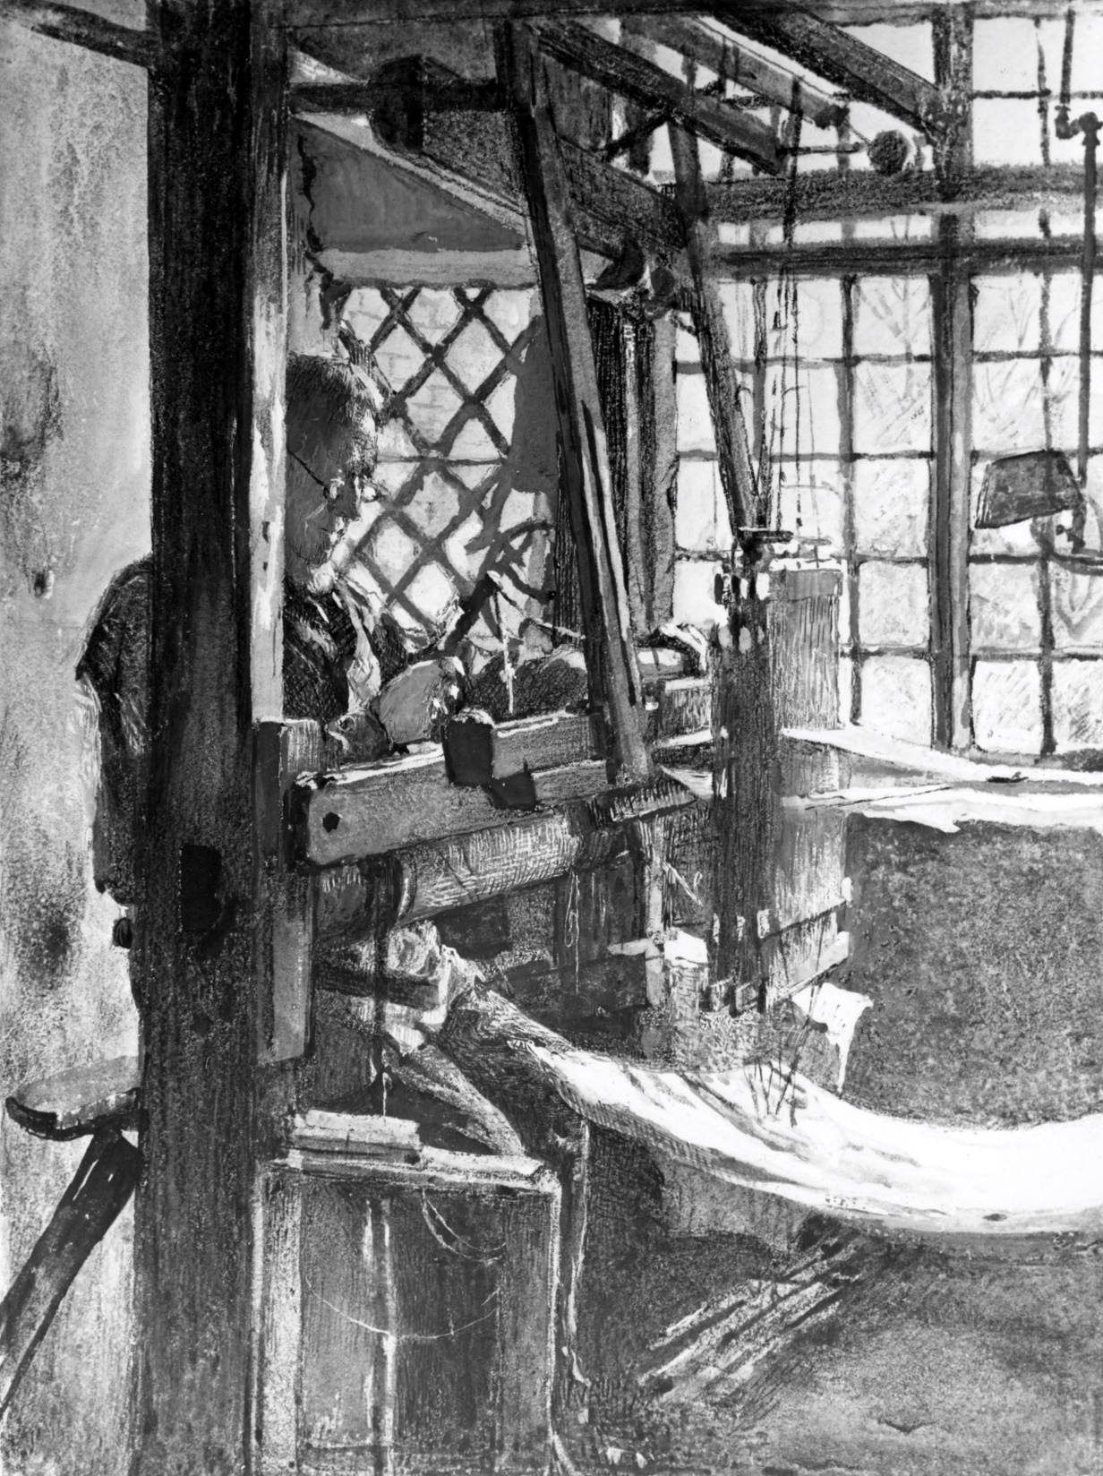
Where we were – the hand loom
Bioinformatician at a workstation
Slow production of results
No provenance
Results not always reproducible

Slide 5
Lots of software to be run – by command line or script

Slide 6
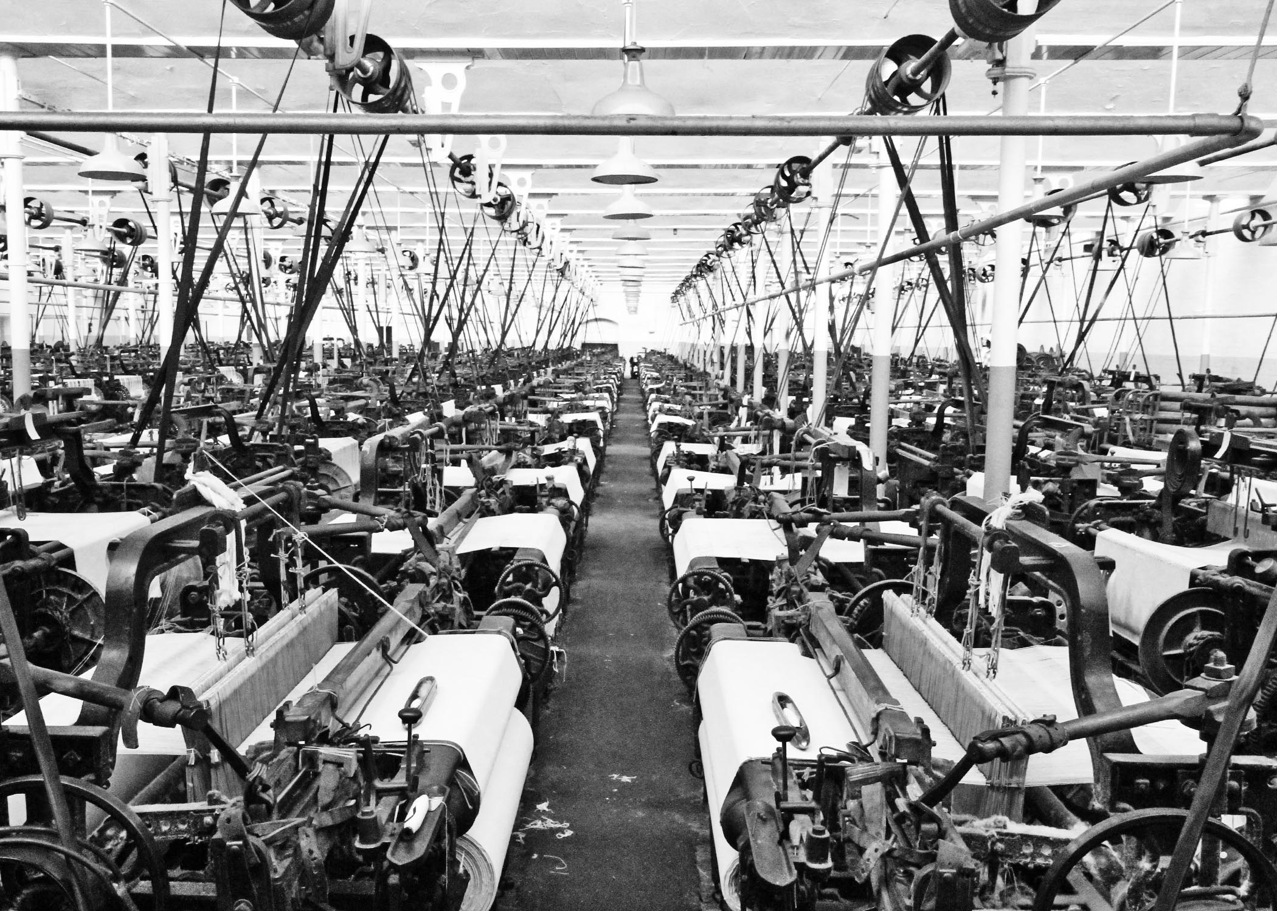
Where we want to be – a factory
Little human interaction with processing
Massive parallel throughput
Easily reproducible results
Remove requirement for knowledge of every process

Slide 7
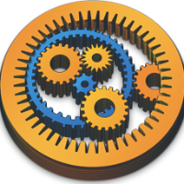
Taverna
“Taverna is an open source domain independent Workflow Management System - a suite of tools used to design and execute scientific workflows”

Slide 8
Useful characteristics of Taverna
“Lego brick”/Component structure
  Create defined and re-usable “Lego bricks” that can be pieced together
  Reduces coding knowledge + effort (such as for debugging)
  Turning entire processes into “black-boxes” (reducing need for expert knowledge)
Provenance → Everything is recorded
  Components (versions and changes)
In-built parallelism to increase throughput
  Run multiple samples
  Run multiple parameters

Slide 9
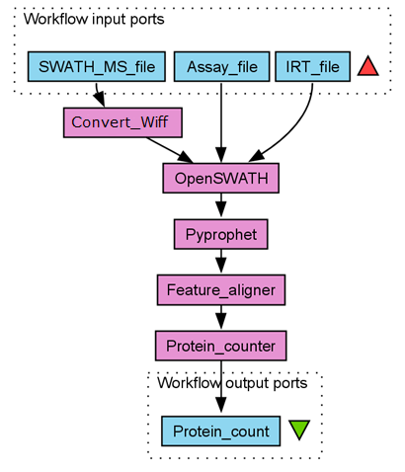
Example of a MS Data Taverna Pipeline
Process is the same as before, but now we can just add some variables and click play

Slide 10
Why Taverna isn’t enough
Steps executed on the Taverna server
Files very large
  Network bottlenecks
  Disk bottlenecks
  Processor bottlenecks
  Not enough RAM (need 64GB+)
Need something beefy to run this on!

Slide 11
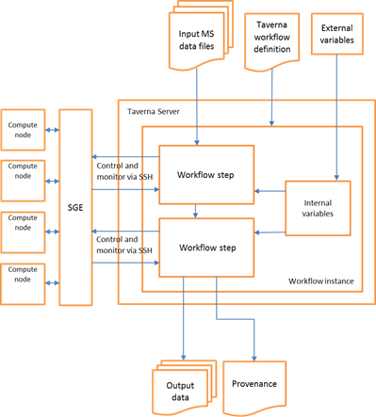
Taverna plugged into DPSF

Slide 12
Performance improvements so far
 | Conversion Time | MS data analysis with Pan Human Library | MS data normalisation | Overall for a single file | Overall for TEN files
Quad core Workstation | 20 minutes | ~16 hours | ~ 1 minute | ~ 17 hours | ~ 1 week
DPSF | 7 minutes | ~4 hours | ~ 1 minute | ~ 4 hours | ~ 4 hours

Slide 13
Where to next?
Improve parallelism by building middleware
Improve parallelism by adjusting tooling to spread jobs across more cores
Cache intermediates for repeated analysis
Build a nice UI

Slide 14
Projected performance
 | Conversion Time | MS data analysis with Pan Human Library | MS data normalisation | Overall for a single file | Overall for TEN files | Overall for 100 files
Quad core Workstation | 20 minutes | ~16 hours | ~ 1 minute | ~ 17 hours | ~ 1 week | ~ 10 weeks
DPSF | 7 minutes | ~4 hours | ~ 1 minute | ~ 4 hours | ~ 4 hours | ~ 2 days
DPSF with improved tooling | 7 minutes | ~ 40 minutes | ~ 1 minute | ~ 48 minutes | ~ 48 minutes | ~ 8 hours

Slide 15
What does this mean?
Quantitative improvements
  Can process larger studies
  Shorter time to publication
  Staff spend less time cranking a handle
Quantitative improvements
  Scientists freed up to ask new questions
  Testing multiple different pipelines
  Exploring previously unchallenged assumptions

Slide 16
Questions?

